Slide 2
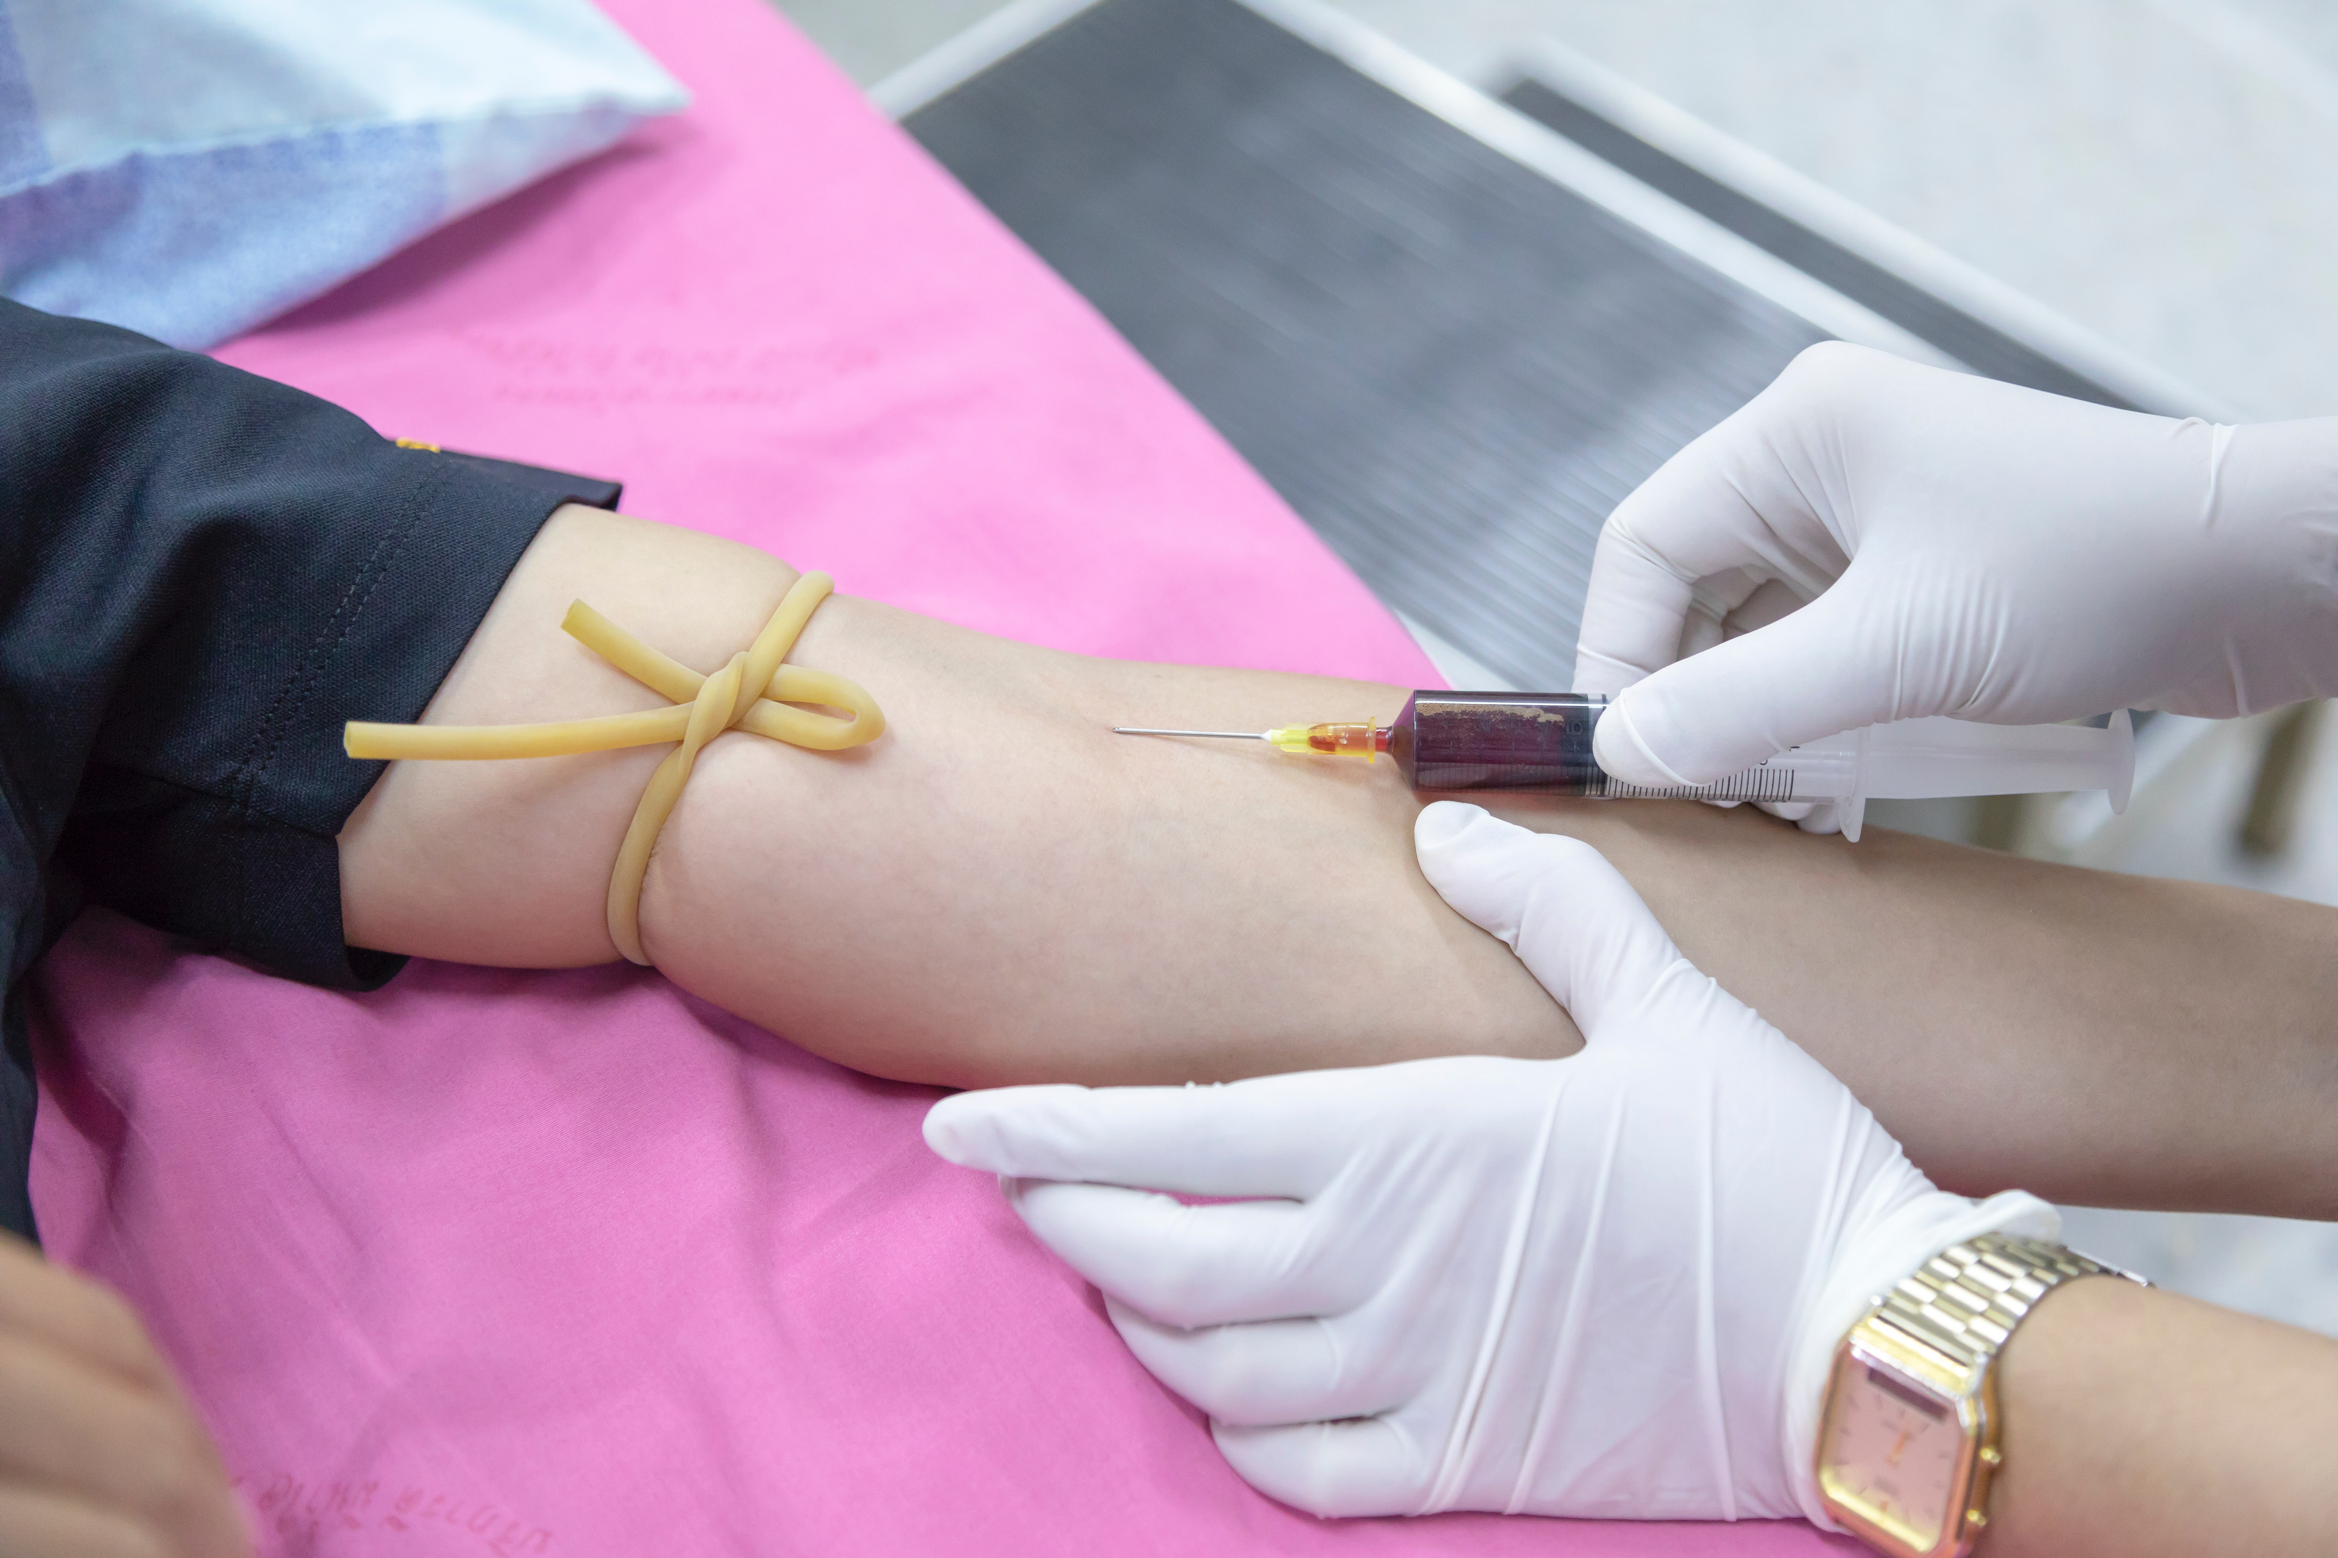
Notes:
Funny story about missed veins

Slide 3
This is why we chose Ultrasound – To improve guidance – Show murky image of ultrasound

Slide 4
Important practical applications of ultrasound that could be more serious than drawing blood
Central venous injection
Parathyroid Injection

Slide 5
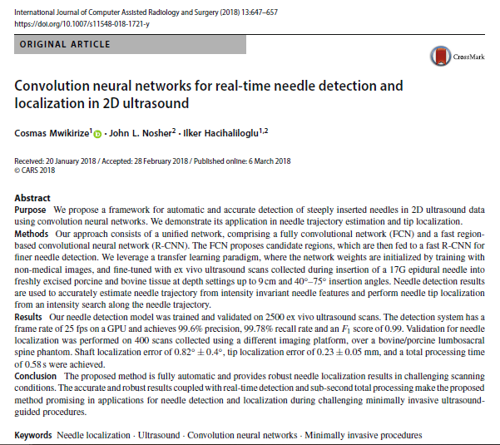
Notes:
Not just a hunch. We know that research interest exists as is evident from the following papers:
Paper 1
Paper 2
Interesting result 3 etc. etc.

Slide 6
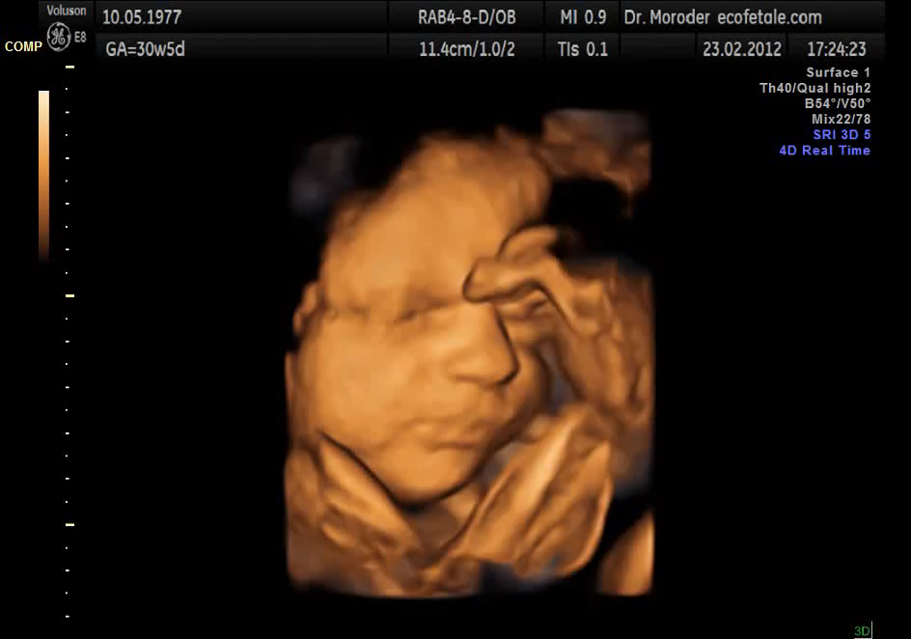
Retrived from Wikimedia Commons under CCA-S 3.0 licence. Author - Moroder
Notes:
What are the main benefits of Ultrasound?
- Fast, inexpensive, universal etc. etc. etc.

Slide 7
But why US? Tracking is better with a sensor no?
Not if you want to keep the surgical workflow the same. Perceptual docking

Slide 8
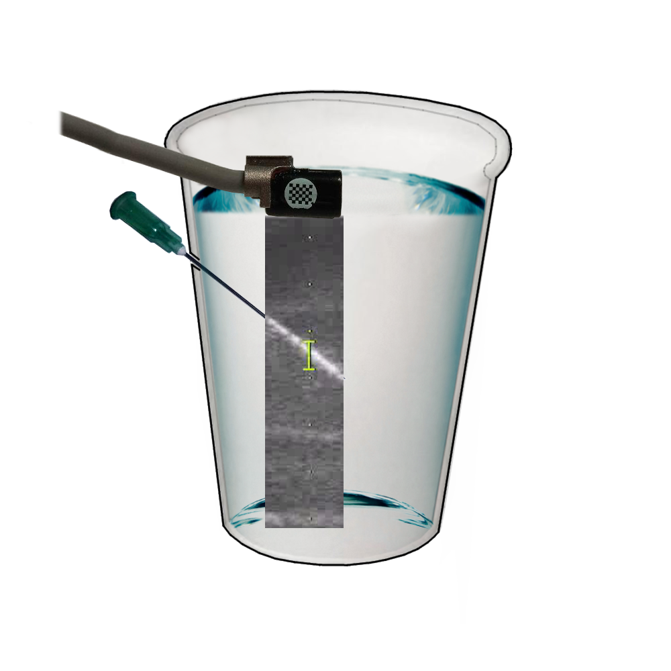
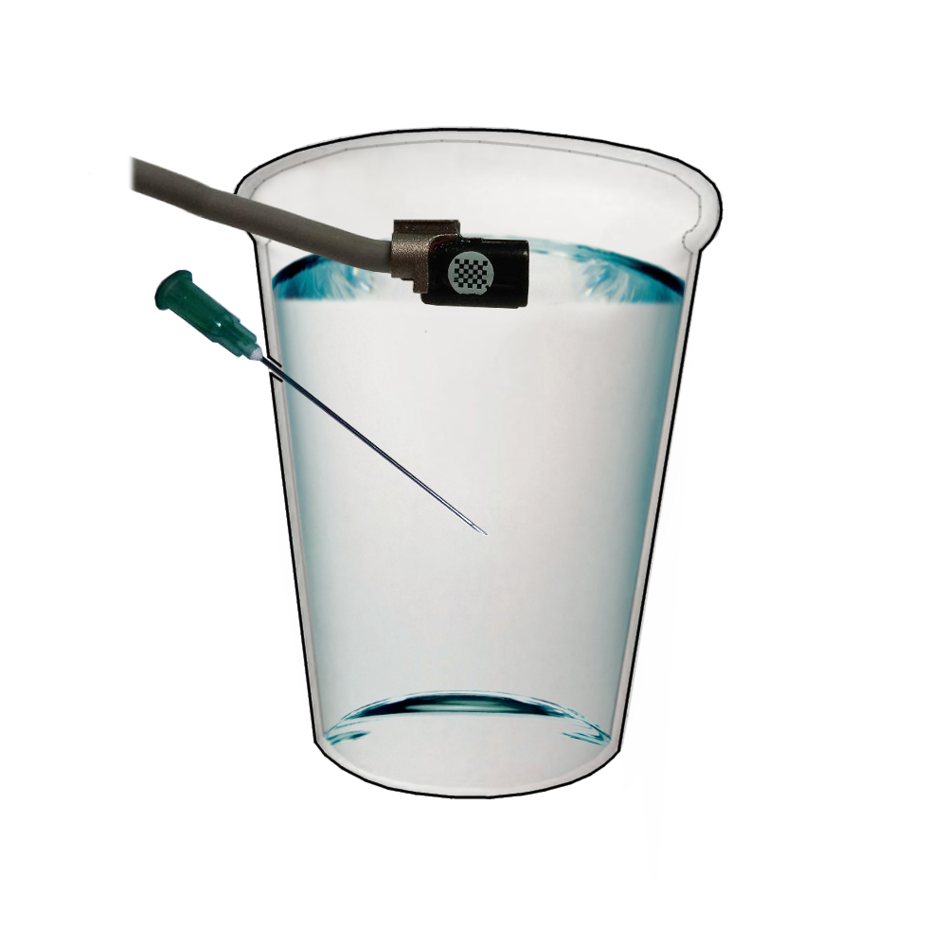
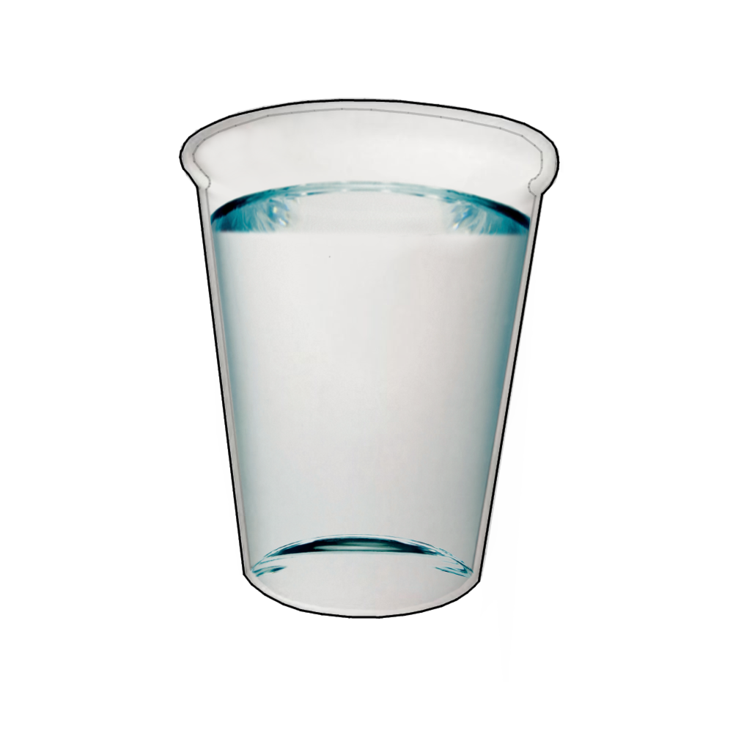

Slide 9
We need some data, of course. This is how we collected it.
- Show video of data collection (muted) or pictures of testing with US

Slide 10
How did we partition the data? Nice diagram here.
Need training and testing data 70/30

Slide 11
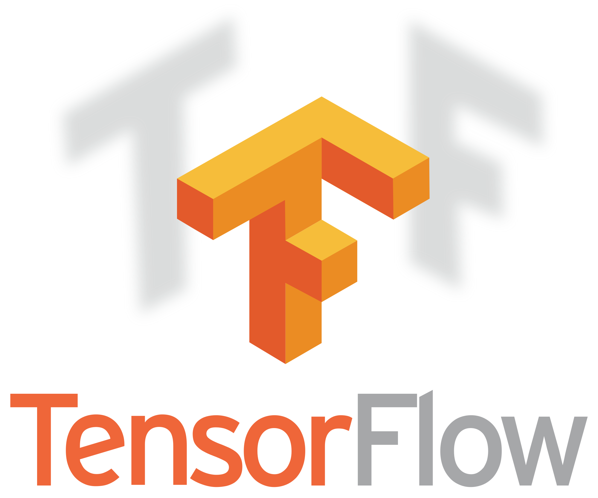



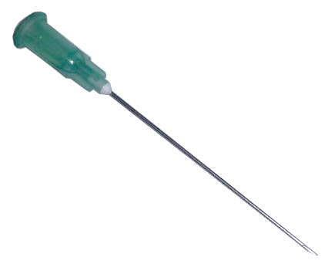
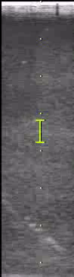
Global Max Pooling
512
256
Softmax
128
Input
1
96
https://upload.wikimedia.org/wikipedia/commons/thumb/1/11/TensorFlowLogo.svg/522px-TensorFlowLogo.svg.png
https://keras.io/
https://upload.wikimedia.org/wikipedia/commons/1/1a/NumPy_logo.svg
https://blog.thedataincubator.com/wp-content/uploads/2017/01/jupyter-logo-300x298.png
Notes:
What did we do with the data?
Placed it in a CNN. WHY?
Because we want this solution to be practical, valuable. CNN can be trained, and can identify new test data cases.
What does our CNN look like?
Flow diagram of the CNN. Explain what is it in greater detail and reiterate importance

Slide 12
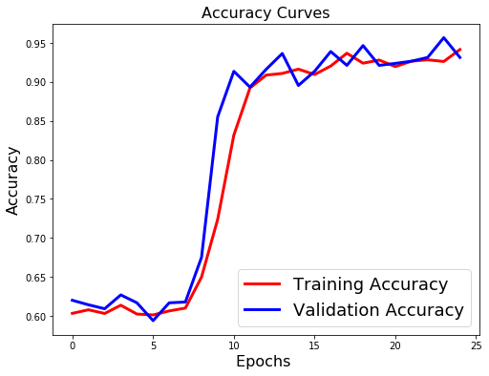
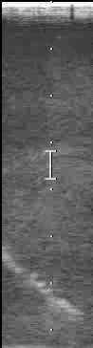
Notes:
These are the results.
94% accuracy with the annotated testing data in water.
Really clean image, so not practical. How about a phantom?

Slide 13
Confusion Matrix
Notes:
These are the results.
94% accuracy with the annotated testing data in water.
Really clean image, so not practical. How about a phantom?

Slide 14
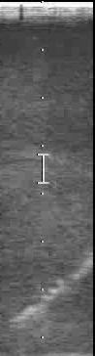
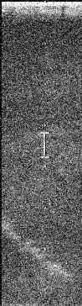
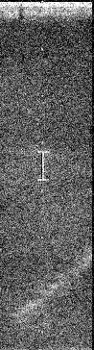
Notes:
Created a new data set with speckling and noise.
How did it perform?
One step further, let’s use a real phantom?

Slide 15
Confusion Matrix
Notes:
These are the results.
94% accuracy with the annotated testing data in water.
Really clean image, so not practical. How about a phantom?

Slide 16
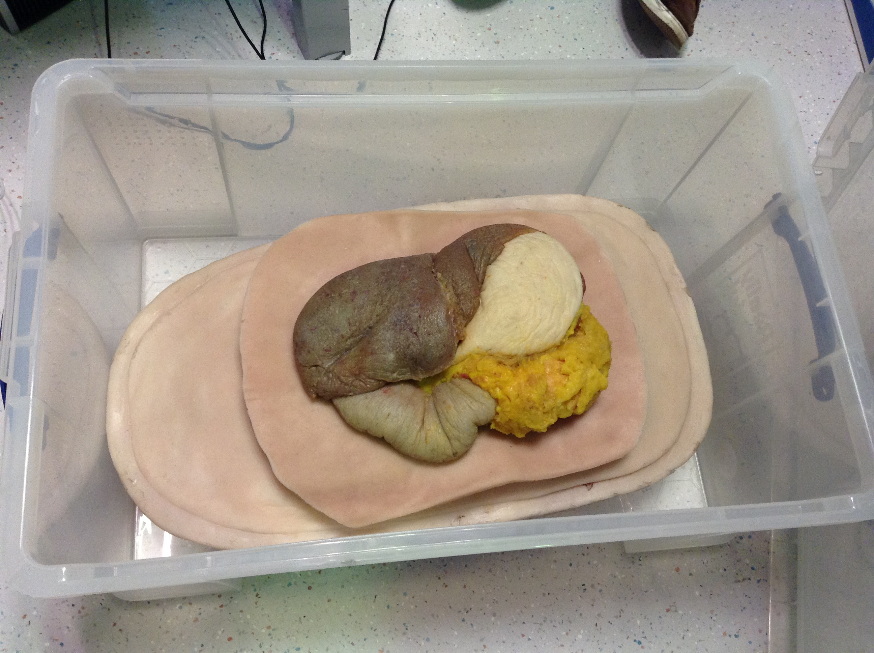
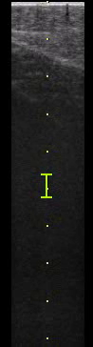
Picture of Ultrasound of the Phantom
Notes:
Used the trained data to identify the needle in a phantom. How did it do?
Here are some pictures of our phantom and the results
Used a phantom silicon model. Placed a needle in the model and performed the same type of scan.
Results?

Slide 17
Confusion Matrix
Notes:
These are the results.
94% accuracy with the annotated testing data in water.
Really clean image, so not practical. How about a phantom?

Slide 18
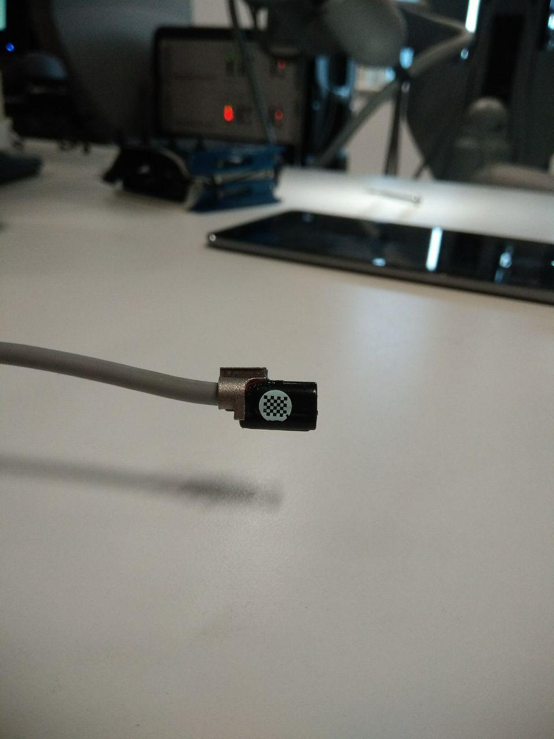
Notes:
How can we make this project better?
Larger dataset
Larger ultrasound probe
Augmenting our training technique (as shown in this paper)
Real-time image processing.

Slide 19
So just to summarise:
Needle detection and guidance is useful, but conventionally has issues that can be approved on with engineering.
We propose automated needle detecting using a CNN.
These are our results. This is where we can improve.

Slide 20
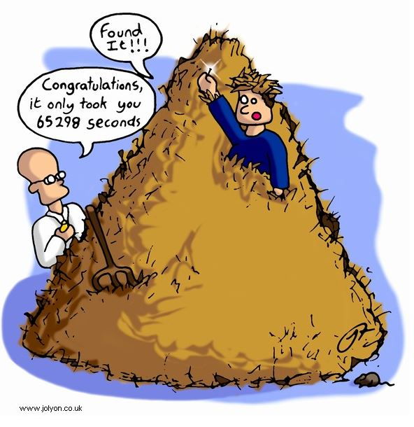
http://www.automatedbuildings.com/news/mar16/reviews/1602180356haystack.html

